Slide 1
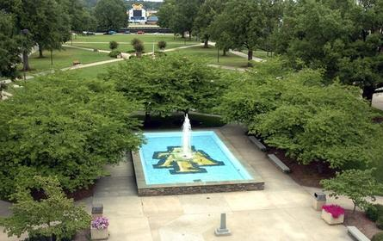
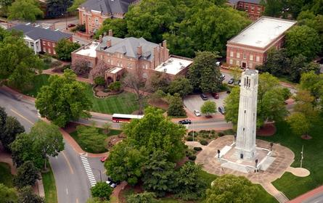
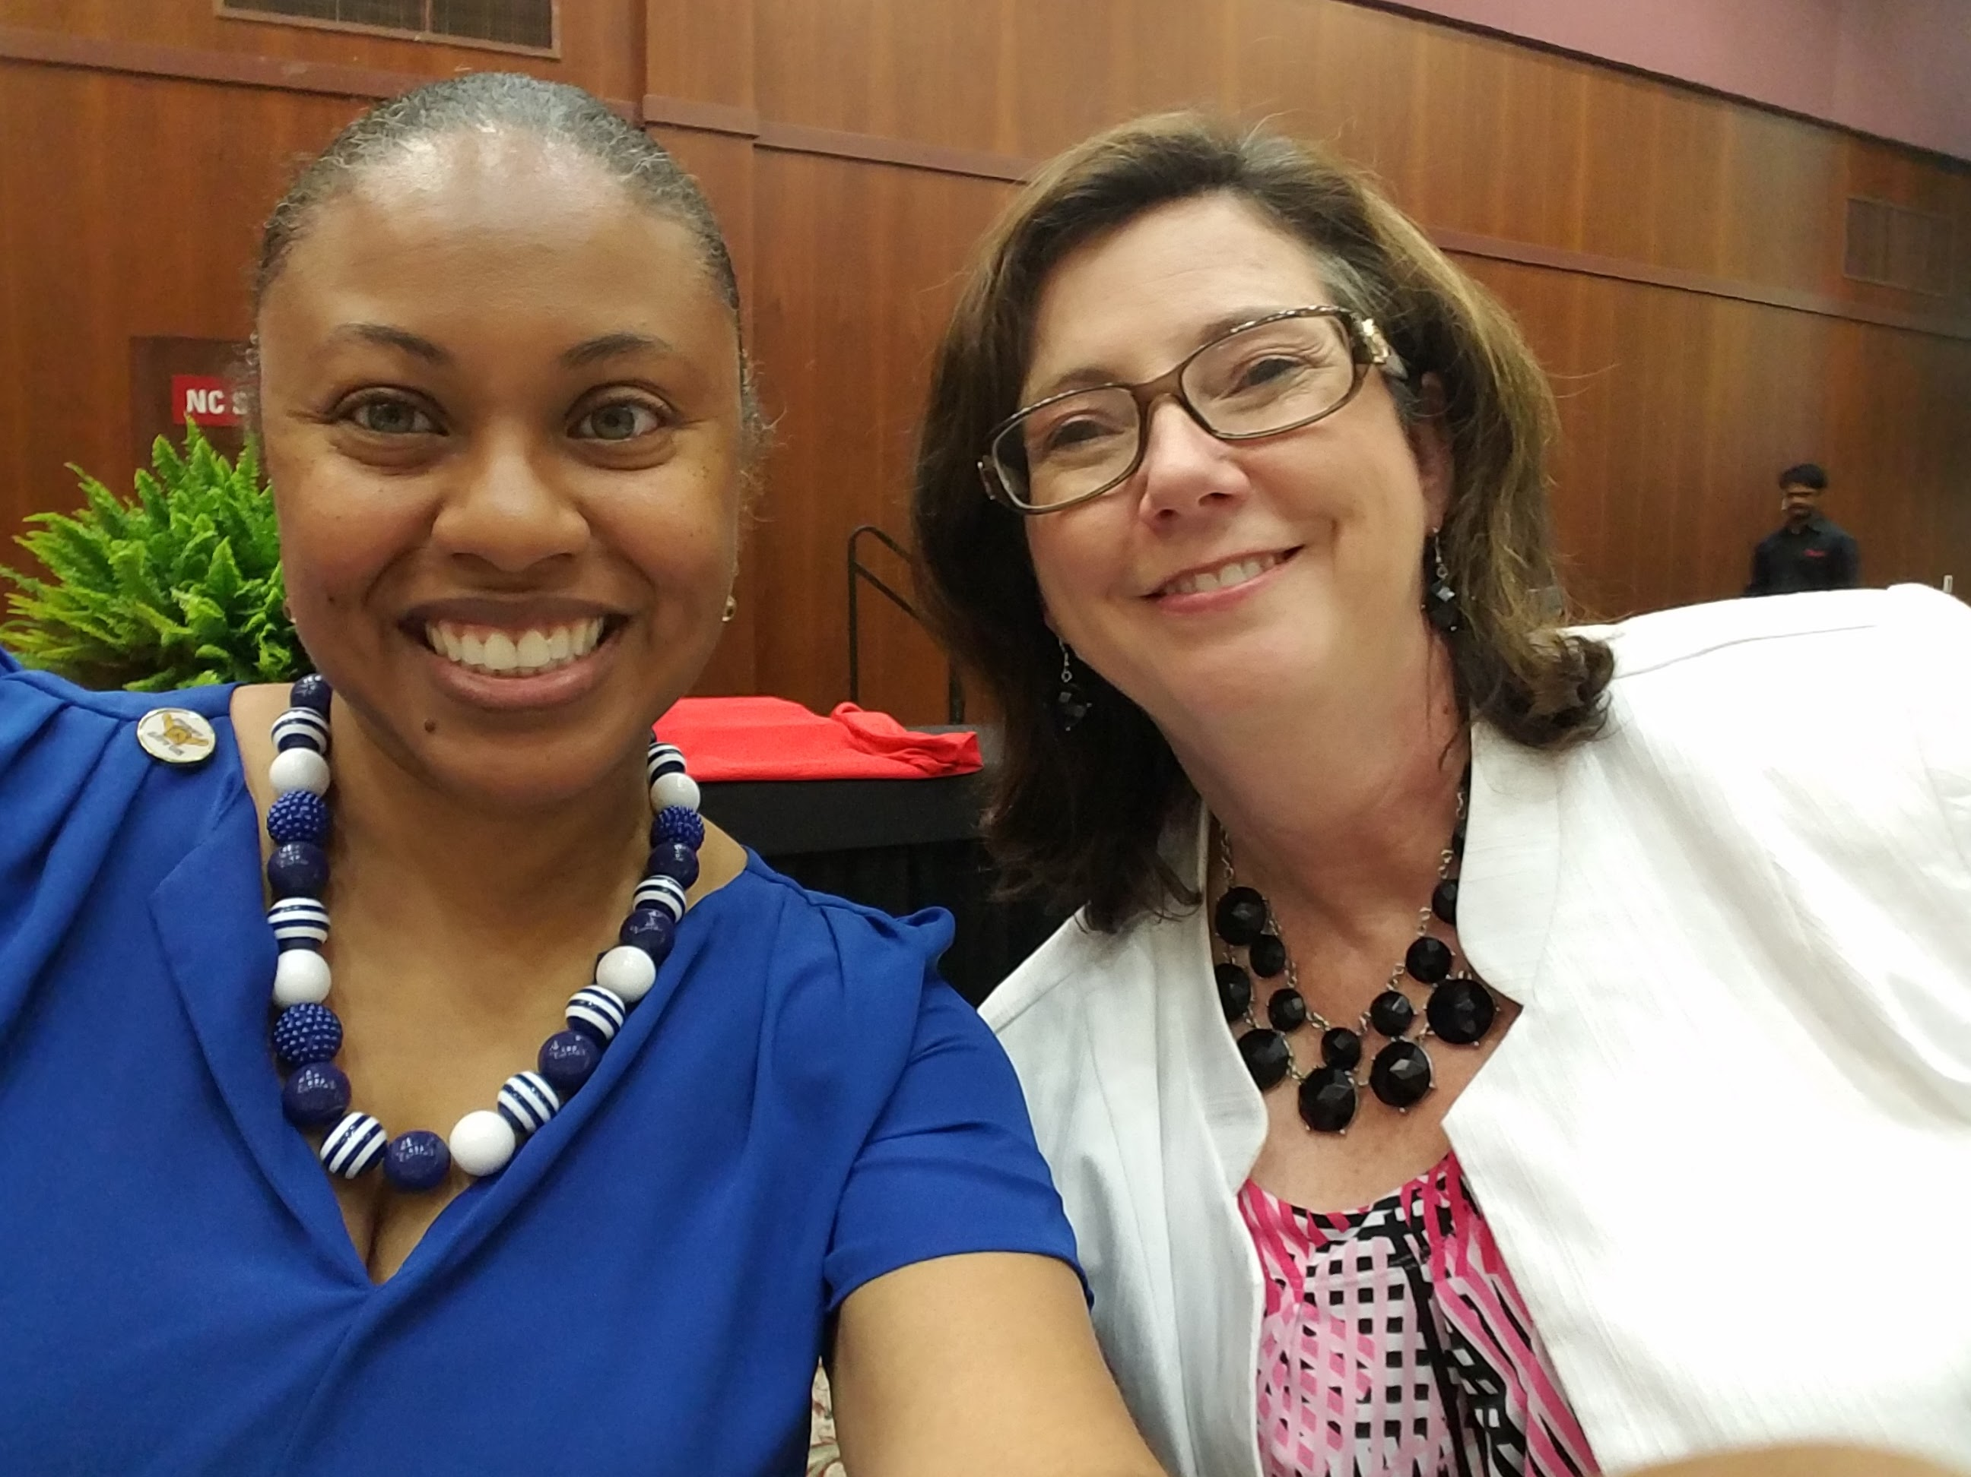
2 Universities – One Program

Slide 2
How We Work Together 2 Universities – 1 program
Trainings
Unit Meetings
State Conference
Crucial Conversations
Grants/Projects
Z Smith Reynolds Grant
Electronic Health Record Project with UNC Health
Justus-Warren Heart Disease and Stroke Prevention Task Force
Social Media
Blog post and Facebook videos

Slide 3
2 Universities – 1 Program = Success
Greater program visibility
Greater support (specialists, partners)

