Slide 1
Dr. Kathleen Liang
Kellogg Distinguished Professor of Sustainable Agriculture
Director of Center for Environmental Farming Systems
North Carolina A&T State University
Coltrane Hall, cliang@ncat.edu 336 285 4683

Slide 2
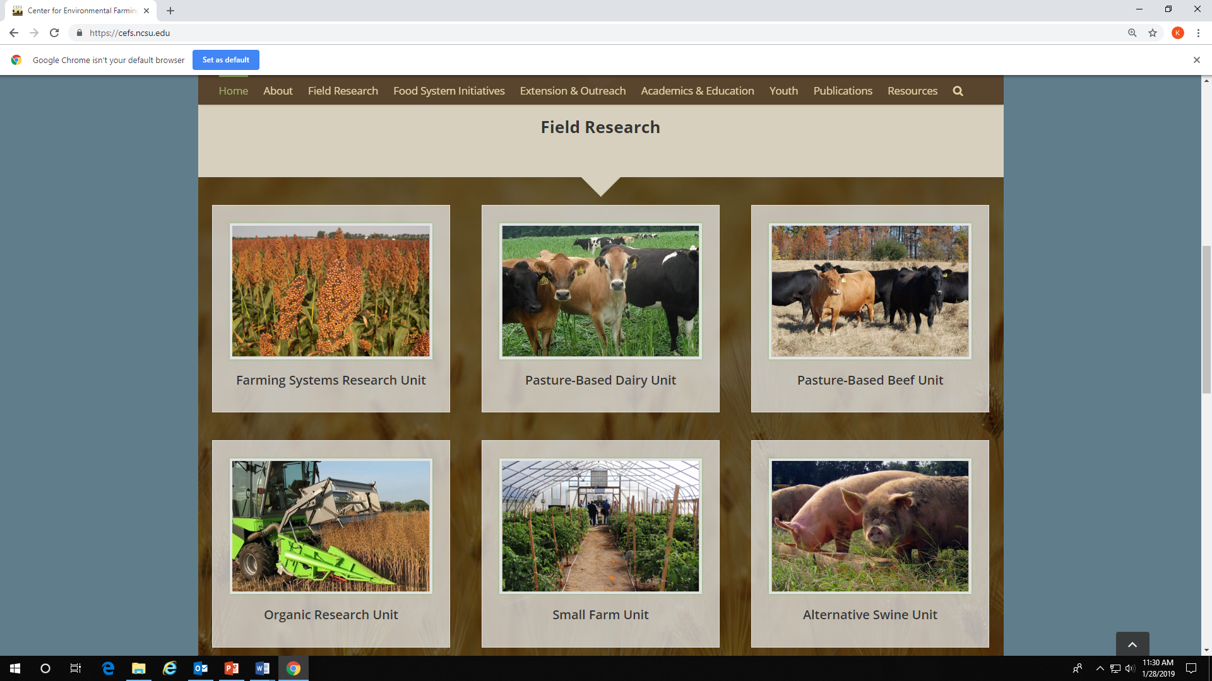

Slide 3
Grants from USDA, NSF, Kellogg Foundation
Engineering, business, agronomy, horticulture, geomatics, geography, policy, computer sciences, cyber security, water and soil modeling
Long-term farm enterprise budget and financial analysis for mixed vegetable production
Food networks, multifunctional ag, and innovation
Big Data intelligence, regional and local price analysis, Integrated human and natural system modeling, beginning farm and rancher training

Slide 4
What do you feel are “good” ground rules for working together when applying for a grant together of getting started on a new initiative or project?
Rules:
Get to know each other better before getting a team together – work style, personality, etc.
When the RFP comes out, start identifying goals and objectives before contacting people.
Recruit key personnel first, then branch out to seek other collaborators if necessary – need track records with certain grants, publications, etc.
Establish and agree upon common rules to work together when writing the grant proposal to avoid confusion and miscommunication. Even if one grant is not successful, there are other opportunities to work together in the future. Keep up the relationships, and don’t burn the bridges.

Slide 5
What have you learned from partnering with your colleague(s) at NC State?
Positive:
Diversified profile of faculty and students
Shared resources and intelligence
Challenges:
Different administrative requirements and standards – proposal approval, individual’s participations, resource commitment, etc.
Time to process paperwork – must start early!

Slide 6
How have you or programming (or outreach) efforts benefitted from this partnership?
It is very rewarding to get to know so many talented people across institutions, learn new things from others, learn about how to deal with challenges while working together, etc.
What opportunities do you see in the future to build upon this partnership?
CEFS is a very well-established partnership in NC. We have great potential to evolve and to promote our work to support others in NC or beyond.
We can build a stronger relationship with Cooperative Extension, industry partners, farmers, and NGOs in conducting joint research and outreach activities for training, and demonstration; Share our knowledge with non-academic audience based on science-derived evidence; Enhance our communication capacity to publish a wide variety of materials beyond journal articles.
We need to continue partnership and support to each other. Make sure NC State, NC A&T, and NCDA are well-represented in each grant we apply for. Together, we can provide more benefits for our population and communities.

