Slide 1
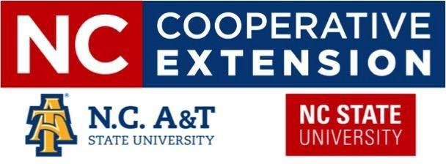
Multi-Institutional Collaboration on
Grants and Contracts
Cathy J. Johnson, Grant Administrator, Grant Administrator/Office of Sponsored Programs, DORED, N.C. A&T State University
Holly Lipkovich, Director of Research Administration, College of Agriculture & Life Sciences, N.C. State University

Slide 2
What is Collaboration?
Collaboration is a mutually beneficial and well-defined relationship entered into by two or more organizations to achieve common goals.
The relationship includes a commitment to establish mutual relationships and goals, a jointly developed structure and shared responsibility, mutual authority and accountability for success, and sharing of resources and rewards.
Collaboration facilitates access to larger projects which only support collaborative grants.
Coordinated teams of investigators with diverse skills and knowledge may be especially helpful for studies of complex social problems.
Collaboration fosters shared recognition and accolades.

Slide 3
Let’s examine interests and expertise in specific areas where collaborations may be possible

Slide 4
Cooperative Extension
NC A&T State University
Strategic Focus Areas | Programs
Small-scale Agriculture Development | 4-H and Youth Development
Natural Resource Sustainability | Agriculture & Natural Resources
Food Safety & Security | Community & Rural Development
Nutrition & Chronic Disease Prevention | Family & Consumer Sciences
Youth, Family and Community Well Being
https://www.ncat.edu/caes/cooperative-extension/ & Cooperative Extension Strategic Plan

Slide 5
Cooperative Extension – Topic Areas
NC State University
4-H Youth Development | Agriculture & Food
Animal Agriculture | Forest Resources
Commercial Horticulture, Nursery & Turf | Community
Health & Nutrition | Farm Health & Safety
Field Crops | Food Safety & Processing
Lawn & Garden | Local Foods
Home & Family | Pest Management
Specialty Crops
https://www.ces.ncsu.edu/

Slide 6
Key Items to Consider When Collaborating
Plan ahead and communicate early with your Colleagues at the other University, including their departments and research offices.
Discuss who does what and how much effort will be attributed to each item.
Ensure your Biosketch and Current & Pending Support is up to date.
Understand the University’s & College’s internal timeline for submission.
Follow agreed upon timeline; if items are late then it impacts the submission of the proposal.
Understand the standard documents required of subcontract sites.

Slide 7
NC A&T State - Standard Subcontract Documents
Statement of Work
Budget
Narrative Budget Justification
(if applicable, completed Subaward R&R budget forms - Grants.Gov)
Biosketches of All Key Personnel
Current and Pending for Key Personnel
Conflict of Interest for Key Personnel
Copy of Institution’s Negotiated Indirect Rate and Benefits policy
Authorized Letter Of Support for Collaboration
Completed and Signed Subrecipient Monitoring Form (attached)

Slide 8
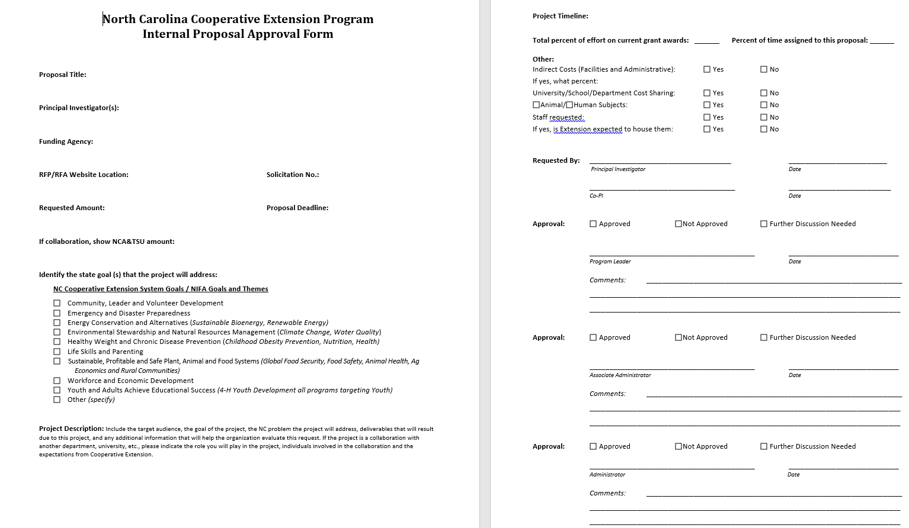

Slide 9
NC State Standard Subcontract Documents
Subrecipient Proposal Package must include the following:
Signed Letter of Intent (LOI)
Statement of Work detailing work to be performed by subrecipient
Itemized Budget and Budget Justification
Federally negotiated IDC Rate Agreement
CV for Key Personnel (Biosketch)
Current & Pending Support
For USDA Proposals: Conflict of Interest Form

Slide 10
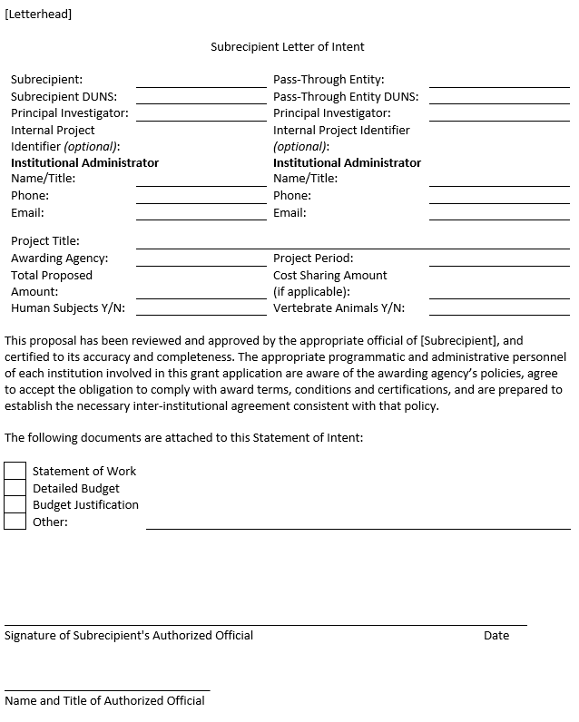
NC State
LOI Example

